Slide 1
Budgeting:
The Power of “Change”
Plan name here
Presenter’s Name TITLE
Notes:
Welcome to Budgeting: The Power of “Change.” As we all know, budgeting can be hard. But it’s important to know why it’s necessary and what it can do for us. Our goal today is to talk about budgeting in ways you’ll find personally useful, so this will be a very interactive meeting. I encourage you to participate and please ask questions.
Speaking of questions, let’s kick off with this one …

Slide 2
Q
why talk about budgeting?
A
to help you make small spending changes that can make a big difference in your savings, and in your life.
Notes:
Why even talk about budgeting?
To help us make small spending changes that can make a big difference in our savings and in our lives—especially in our financial well-being.

Slide 3
today’s
goals
Benefits of budgeting
Current spending habits
Strategies for following a budget
How Transamerica can help
Notes:
Today’s goals are pretty simple. We’ll talk about:
The benefits of budgeting
We’ll take a closer look at what your spending habits are
We’ll discuss strategies for making and sticking to a budget
And last but not least – I’ll tell you how Transamerica can help.

Slide 4
benefits of
budgeting
Better control of your finances
More money to do what you enjoy
Protect and improve your credit ratings
Be more confident about your finances
Avoid overdraft charges and late payments
Save to live the life you want
Notes:
Here are a few benefits to living on a budget suggested by the National Financial Educators Council.
Is there one you can think of that’s not here? (Pause) How about the peace of mind that comes from having some money socked away and from not living hand to mouth? Would you sleep better if you could save more money? To be a good saver, it helps to understand how we spend.

Slide 5
understanding how we
spend
Living beyond your means
Living at your means
Living beneath your means
Notes:
Living beyond your means is when you outspend your income. In other words, when you buy the BMW you can’t afford instead of the Chevy or Honda you can afford.
Living at your means is when you spend everything you earn. Not any more, not any less.
Living beneath your means is when you have money left over. In other words, you don’t always spend every dollar you earn.
What type of spender are you? Let’s try to find out.

Slide 6
what type of spender are
you?
 | Examples of living…
1. | Live on a budget and regularly put money in a savings account?
2. | Live in a nice house, but struggle to cover your homeowner’s insurance and property taxes?
3. | Work hard, play hard, and live for today—without running up debt?
4. | Juggle 4 or 5 credit cards which are often maxed out?
5. | Eat at nice restaurants, but only after your bills are paid and you put some money in savings?
Beyond
At
Beneath
$
$
$
$
$
Notes:
[RPC: Ask each of the questions on the slide; an audience member should say what kind of “spender” that habit falls under. Then reveal the answer.]
Do you identify with any of the three groups? Are you a combination of two? Maybe even a combination of all three?!
Here’s another useful way to look at spending …

Slide 7
essential vs. discretionary
spending
Essential |  | Discretionary
Housing |  | Concerts
Car |  | Dining out
Car insurance |  | Travel
Retirement savings |  | Gifts
Notes:
Look at your spending and ask this question: Is this purchase essential—in other words, is it for something you must have? Or is it discretionary—is it for something you want to have? Ask that question of all your expenses, even if the cost is small. Discretionary spending is where you can cut back and save money. Here are some ways we sometimes overspend.

Slide 8
how we sometimes
overspend
Notes:
[RPC: This is the “home slide” for a conversation about over-spending. It covers six areas: groceries, vacations, golf, buying lunch, coffee, entertainment. Ask audience what areas they may be over-spending in. Call on someone and you can click on the icon for that specific topic. You’ll then see a new slide with a breakdown of how that spending adds up over time. To get back to the home slide, click on the colored icon. To move past the home slide, click in the white area (not on any of the icons).]
There are lots of ways we overspend. It could be on groceries … vacations … golf (although some people would say there’s no such thing as too much golf!) … buying lunch every day at work … pricey coffee … handbags and clothes we don’t really need … and on and on … the list is endless.
How much could you save if you didn’t spend money on those things? It can add up in a big way. Take a look at some rough calculations based on some standard assumptions. (Click some items and discuss.)
Now that we’ve taken a look at how we spend, and maybe overspend, let’s begin building a plan that will allow us to experience the power of change. To start budgeting and saving, it helps to change our perspective. Here’s what I’m talking about …

Slide 9
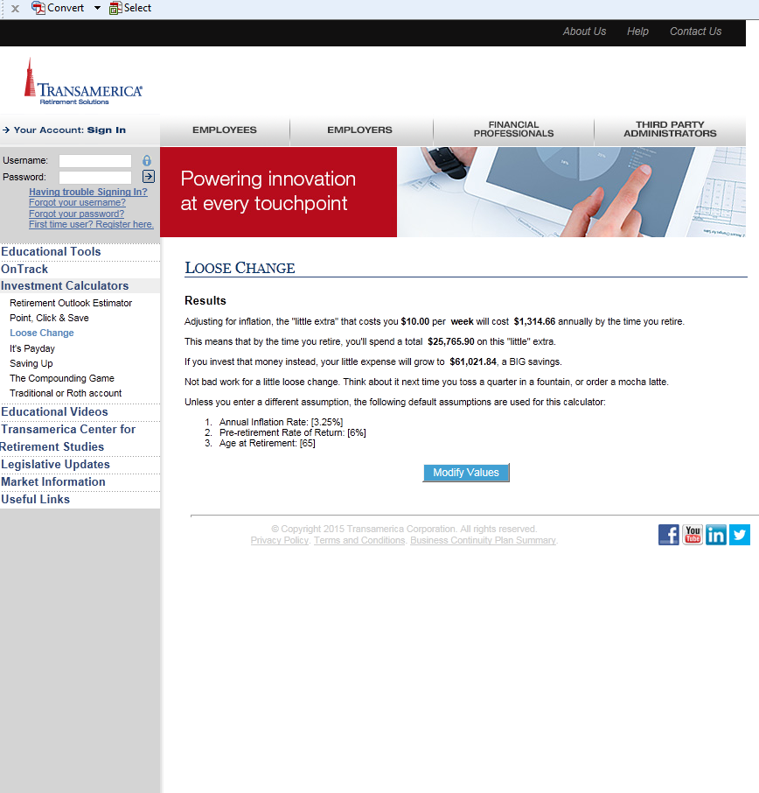
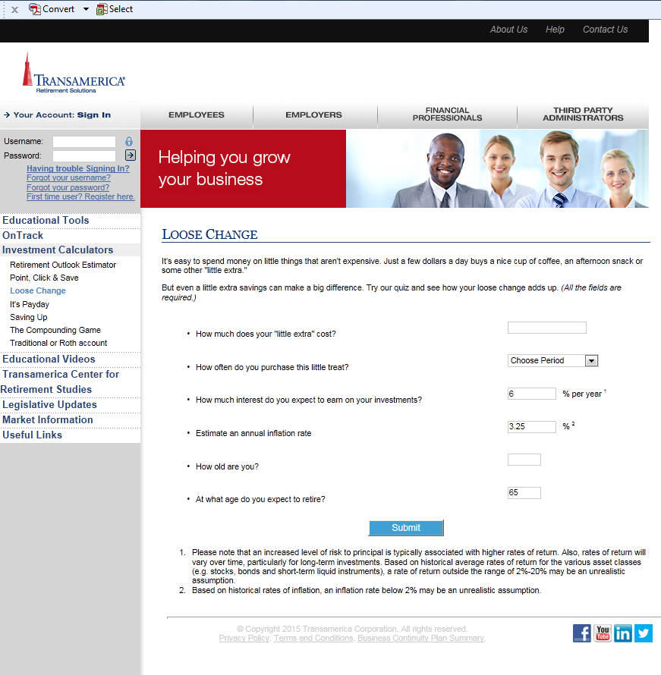
loose change
adds up
TA-Retirement.com > Employees > Resources > Investment Calculators
Notes:
[FOR EM PLANS ONLY]
If you’re still not buying it – try it out yourself with this simple online calculator called Loose Change. It can show you how small savings can make a big difference.
The key is something Albert Einstein called “the eighth wonder of the world.”

Slide 10
the power of
compounding
“Compound interest is the eighth wonder of the world.” — Albert Einstein
Notes:
How many of you are familiar with the term “compounding,” also known as compound interest? Albert Einstein called it the eighth wonder of the world. In simple terms, compounding can be thought of as “interest on interest.” It’s when your initial savings earns interest … and then that money (plus your initial savings) earns interest … and then all of that money (plus your initial savings) earns interest … etc., etc.
With compounding, the younger you start saving, the better. And the next best thing to starting early is starting now.

Slide 11
changing our
perspective
Notes:
What do you see in this picture? Go ahead … take a minute.

Slide 12
changing our
perspective
Old Woman
Young Woman
Eyes
Lashes
Nose
Nose
Lips
Jaw Bone
Chin
Necklace
Notes:
Do you see the old woman? … or the young woman? They’re both here. A slight paradigm shift will reveal the alternate figure. Consider a similar paradigm shift when creating your household budget.
When asked to prepare a budget, most people will use the following logic: I earn X and I spend Y, so on a monthly basis I’m able to save Z. A better way to budget would be: I earn X and I want to save Z, so I will limit my additional monthly expenses to Y.
The big point I’m making is this … (click to next slide)

Slide 13
pay
yourself first
1: Write down your monthly take-home pay
2: Subtract the percent you want to save (minimum 10%)
3: Subtract your essential expenses
4: The remaining amount is for discretionary expenses
Notes:
Your retirement savings must be part of your budget. This is crucial. These 4 basic steps can help.
(Presenter to read 4 steps.)
Just as you pay $1,500 to the bank for your mortgage, $250 to Honda for your car lease, and $60 to Verizon for your phone bill, you should pay Z amount to yourself for retirement. How much should Z be? Most experts say it should be a minimum of 10% of your take-home pay.
Finding the right balance between living for today and saving for tomorrow can be tough. But if you develop the habit of paying yourself first, you’ll enjoy the benefits of financial security.
How can you start creating a monthly budget? I’m glad you asked.

Slide 14
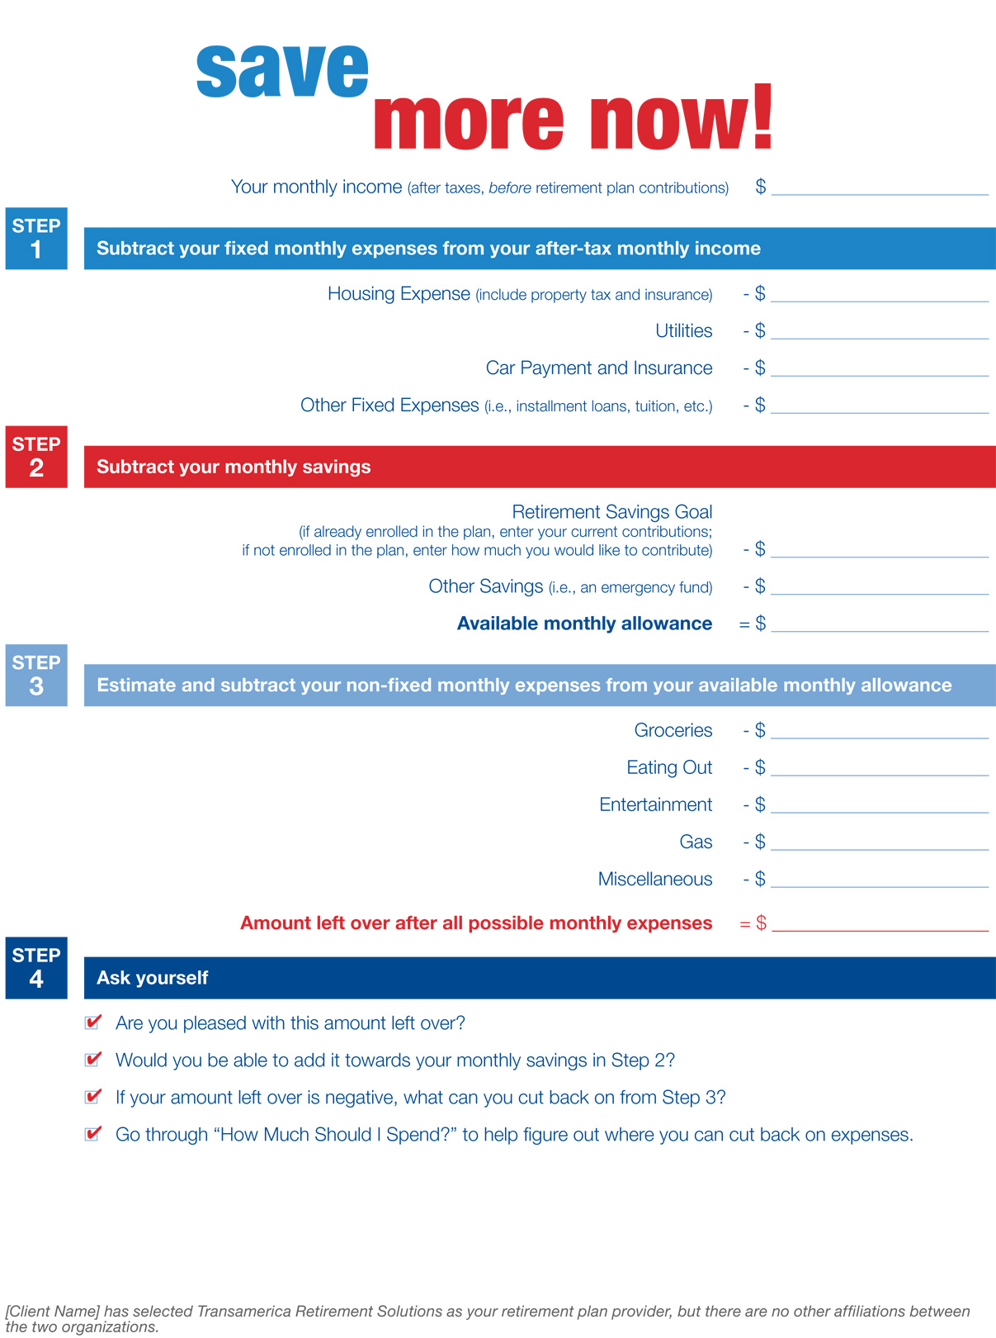
getting started:
part 1
Notes:
[RPC: Be sure to order these worksheets off WebCRD and pass them out before or after the presentation.]
This worksheet – Save More Now – will help you examine your essential and discretionary expenses, and where you stand at the end of each month – do you have enough money left over that you could potentially increase your savings rate? Or maybe you’re seeing a negative number at the end of the month, which means you need to think about ways to cut back – and that’s where this worksheet comes in…

Slide 15
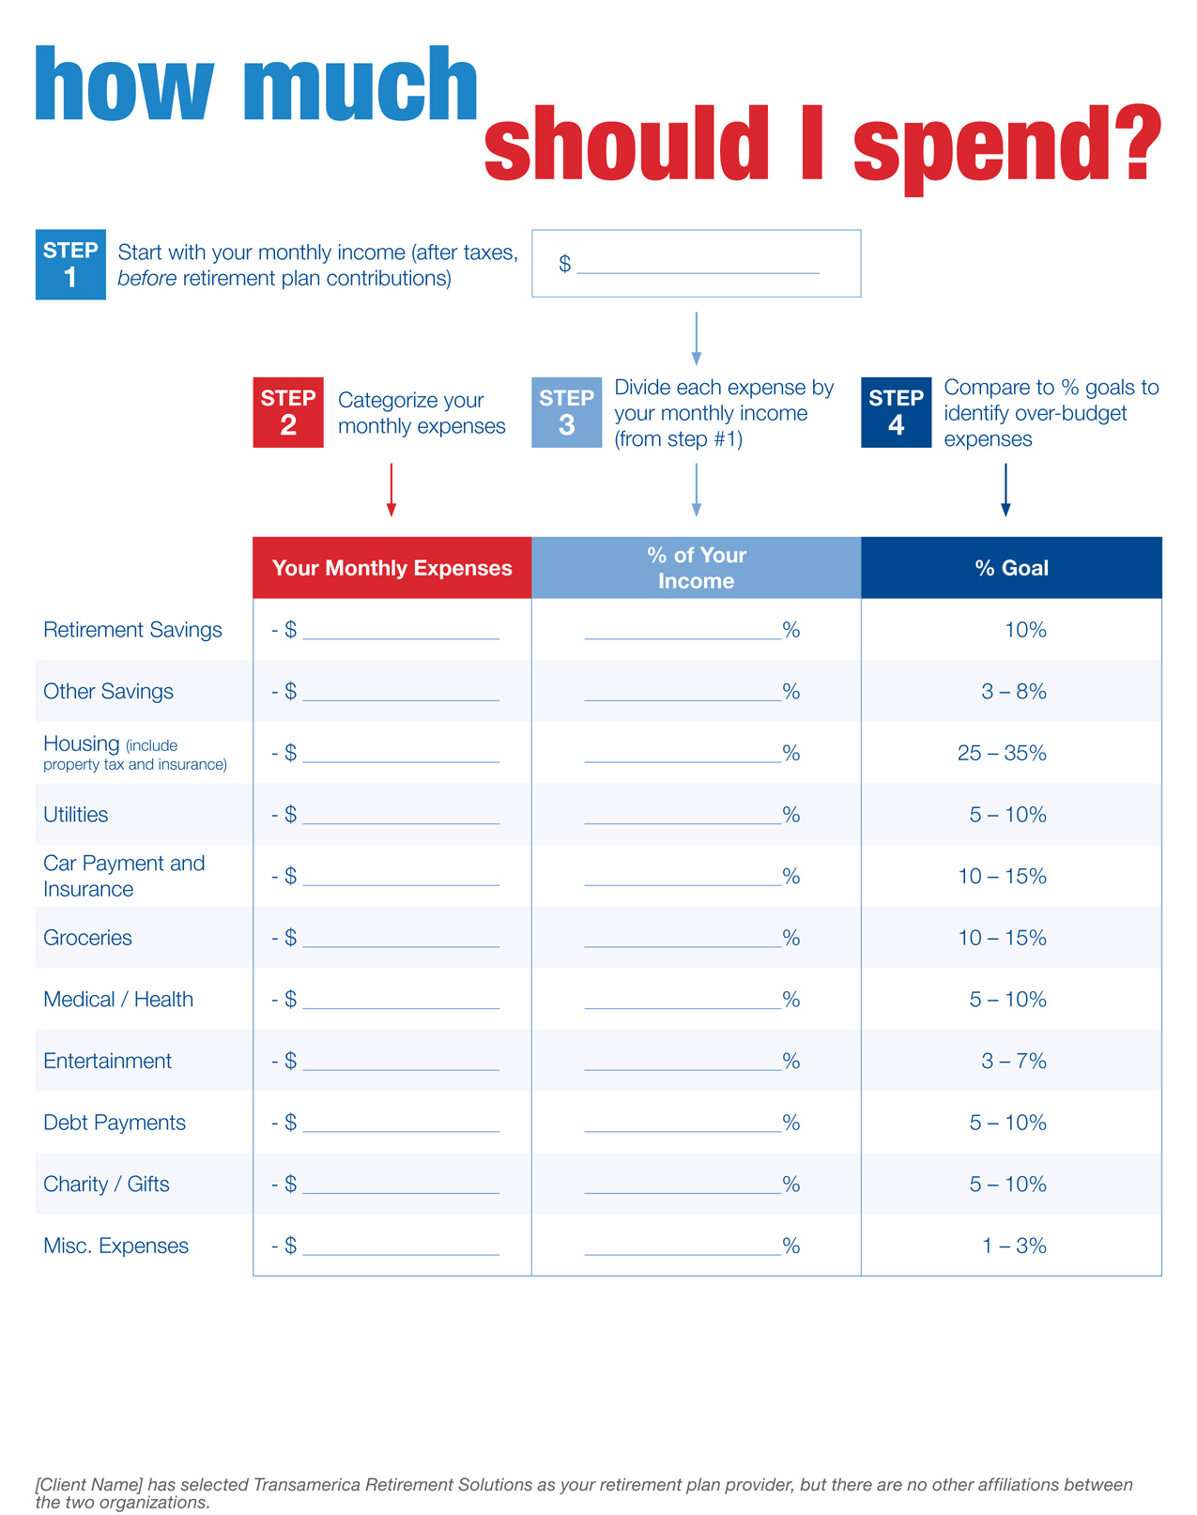
getting started:
part 2
Notes:
How Much Should I Spend can help you figure out how much you should spend on major items in your monthly budget. And it could help identify areas that should be trimmed back. They’re simple and easy to use. I urge you to spend some time with them.

Slide 16
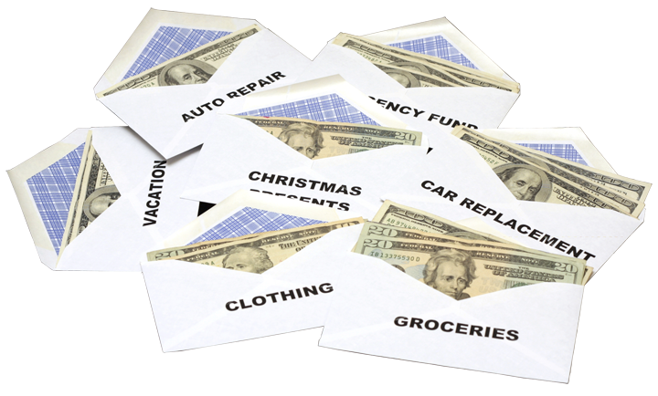
sticking to a budget:
the envelope system
Notes:
[OPTIONAL SLIDE]
Here’s another way to make a budget: get a bunch of envelopes. On each one, write the name of a big item—stuff like groceries, restaurants, entertainment, gas, and clothing.
Let’s say you budget $400 a month for groceries. When you get your first paycheck of the month, write yourself a check for $200, cash it, and put the cash in the envelope labeled “Groceries.” When you get paid again, write another $200 check. That’s your $400 for the month for food. No money comes out of that envelope except to pay for groceries. If you have $100 in the envelope and you run up a bill for $120, take some things out of the cart. Put any change back in the envelope. If you want to go to the store but don’t have enough money, then raid the fridge for leftovers.
When the money runs out of an envelope, don’t spend any more until new money goes in there. If you have money left over in an envelope at the end of the month, congratulations! It’s okay to celebrate—within reason. Reward yourself if you’d like by going out to dinner or rolling the money over to the next month so you have a bigger food budget.
Important: Don’t shift money from one envelope to another. It can be tempting. For example, if you use up all your “Eating Out” money, you may want to reach for the one marked “Clothing.” Please don’t do it! The purpose of envelope budgeting is to curb your spending and teach you discipline. It may not be easy—but it works. There’s even an online version …

Slide 17
budgeting:
there’s a tool for that
Online version of the envelope system:
BudgetEase.com
Other useful tools:
Mint.com
BillGuard.com
HelloWallet.com
MoneyWizApp.com
GoodBudget.com
YouNeedABudget.com
Toshl.com
SpendeeApp.com
Notes:
If you go online, you’ll find lots of sites and apps that can help you create a budget and save. Some, but not all, are free. Please keep in mind Transamerica is not endorsing any of these tools—we’re sharing this information because it may be useful.

Slide 18
another tip:
minimize
credit card use
Notes:
One tip that can help you live on a budget is to not use your credit cards—or at the very least, use them wisely. I know … our society is becoming more and more cashless and it may be impossible to abandon your credit cards. But paying in cash—and using your debit card instead of your credit card—will put you in touch with your expenses and make them real. Credit cards make spending easy because you don’t see the money leaving your wallet. Try, as much as possible, to not use your credit cards. However …
If you’re disciplined and don’t overspend, there could be benefits to using credit cards. I have a friend who was determined to go on a vacation to Europe. Plane tickets are expensive—she knew they were not in her budget. But she and her husband decided to use a credit card with a miles program. They put all their regular shopping on the card—groceries, the occasional movie, everything—and paid it off every month. It took three years, but they’re going to Italy this summer with free plane tickets thanks to their smart use of credit cards. [RPC: ask if anyone else has “positive” credit card stories like this.]

Slide 19
another tip:
track all
expenses
Notes:
Budgeting takes discipline. Here’s an exercise that will help build it: For an entire month, keep a written record of every dollar and dime you spend. Ask for receipts of everything, and save them. At the end of the month, examine your spending record, along with your credit card statement. What you’ll see is not only how you spend money, but how you may be wasting it.

Slide 20
another tip:
value your money
Figure out how much you earn for each hour you work
Think of that number when you go shopping
Notes:
When you go shopping—especially for something not essential—figure out how many hours of work it will take to earn what the item will cost. Then ask yourself this simple question: Is it really worth it? Is the item worth all the hours you’ll have to work in order to earn it?
For example: If you want to buy a guitar for $300 and you earn $15/hour, then the guitar will cost you 20 hours of working.
If you want to take a $1,500 vacation and earn $25/hour, then the vacation will cost you 60 hours, or a week and a half of working.
Saving even small amounts of money is important. Here’s a big reason why …

Slide 21
the importance of an
emergency fund
How long could you support yourself if you lost your job tomorrow?
Less than 1 month
Less than 3 months
Less than 9 months
9 months or more
Notes:
[RPC: ask how much time they think their emergency fund should cover.]
With the money you have on hand, how long could you last if you lost your job tomorrow? If you don’t have an emergency fund, building one is very important. How much money should be in it? In a two-income household, your emergency fund should equal 3 to 6 months of expenses. In a one-income household, it should equal 6 to 12 months of expenses. Emergencies happen—your emergency fund may help you get through them without going into debt.
How can you start saving money immediately? Here are some tried and true methods.

Slide 22
10 simple ways
to save
Go grocery shopping with a list—and stick to it
Use online coupon services: Groupon, Living Social, and Zulily
Weatherproof your home to reduce energy bills
Keep tires properly inflated to save gas
Look for “triple play” deals on phone, internet, & cable TV
Cook from scratch more often
Bring lunch to work as often as possible
Don’t buy snacks from a vending machine
Use a programmable thermostat
Put aside a small amount to treat yourself every month
Notes:
If you go online and Google “how to save money” you’ll find dozens and dozens of tips—here are a just few. It’s important to always look at your spending for ways to save. Who has another saving tip they want to share with the group?

Slide 23
common obstacles to
budgeting and saving
I’ll get around to it … later
Spending makes me feel good
Raising kids is expensive
My spouse insists on spending
I’ll get serious about it when I’m older
We have other priorities
We live paycheck to paycheck
My house is my retirement nest egg
Life is too short to deny myself pleasure
I’ll start saving more when I earn more
I play the lottery every day
We need a yearly vacation
Notes:
Abraham Lincoln said, “You cannot escape the responsibility of tomorrow by evading it today.” There are lots of obstacles to budgeting and saving—most can be overcome. What are some of your reasons for not budgeting and saving?

Slide 24
who is in
control?
Notes:
Ultimately, how you spend, how you budget, and how you save is up to you. (I know … your spouse has a big say in these matters!) You’re the one who has to decide how seriously you’re going to take this. It’s your life. It’s your retirement. The more thought and effort you’re willing to put into budgeting and saving, the more successful you’ll be.

Slide 25
how Transamerica
can help you
Easy access to your retirement account
OnTrack®
Calculators and apps
Trained experts for personalized help
You should evaluate your ability to continue the auto-increase service in the event of a prolonged market decline, unexpected expenses, or an unforeseeable emergency.
Notes:
Script notes:
I’d also like to mention some of the many ways Transamerica can help you prepare for retirement.
Easy Access - log on any time to [my.trsretire.com] [TA-Retirement.com] [custom URL] to access your account.
OnTrack® – a comprehensive online tool that gives you a personalized look at your finances and shows if you’re on course toward meeting your goals. Everyone in a Transamerica retirement plan can tell if they are on track to meet their goals by using this tool.
Calculators and apps – easy to use online tools and apps that tailor advice to your needs, no matter where you are in your journey to retirement.
Trained experts for personalized help – I’m here for you as a resource, and am happy to help you one-on-one with some the big and little decisions you’ll need to make on the road to retirement.
IF THE PLAN INCLUDES AUTO-INCREASE, mention that your contributions will increase automatically every year. IF NO AUTO-INCREASE, delete the disclosure in the slide.

Slide 26
action!
take
Think about how you spend money.
Identify at least one item you can cut back, and redirect toward savings.
Use the worksheets to create a budget that pays you first.
Commit to at least one tip to help you stay on course.
Notes:
I’d like to close by asking you to please not wait to take action. (Presenter to read actions on slide.)

Slide 27
action!
take
Build a cash reserve.
Begin saving into your retirement plan, or increase your contribution (target 10%+).
Save at least 1% more this year than last.
Notes:
Thank you all for attending. (If time permits:) Are there any questions? (Remember to offer the two worksheets.)

Slide 28
ONTRACK® slides
About Probability Illustrations, Limitations, and Key Assumptions
The probability illustrations the OnTrack® tool generates are based on “Monte Carlo” simulations of 500 possible investment scenarios for a given time period and assume a range of possible returns. The illustrations are generated according to models developed by Ibbotson Associates, a leading independent provider of asset allocation, analytical, and wealth forecasting software. The Your Retirement OutlookSM graphic reflects the difference between the model’s estimated annual income (which corresponds to a 70% probability of achieving your income goal in the investment scenarios simulated) and your annual income goal.
When forecasting the probability of achieving your income goal, the model employs different returns for different asset classes, based on Ibbotson’s capital market assumptions developed using historical and forward-looking data. Current assets are assigned to asset classes based on Morningstar categories, and fees and charges inherent in investing are incorporated with an average fee assumption for each asset class. The historical and forward-looking benchmarks used for modeling the various asset classes are below. Return assumptions are updated annually; these updates may have a material impact on your projections. Return assumptions are estimates not guarantees. The returns you experience may be materially different than projections. You cannot invest directly in an index.
.

Slide 29
ONTRACK® Tool: Benchmark Indexes
Lower Risk/ Volatility
Asset Class | Forward-Looking Benchmark | Historical Benchmark
Cash | Citigroup 3-Month Treasury Bill | Ibbotson SBBI T-Bill Index
Short-Term Bonds | Barclays U.S. Treasury 1-3 Yr Term Index | Ibbotson 2 Yr Treasury Index
TIPS | Barclays Capital U.S. Treasury: U.S. TIPS | Ibbotson TIPS Index
Aggregate Bonds | Barclays Capital U.S. Aggregate Index | Barclays Capital U.S. Aggregate Index
Long-Term Bonds | Barclays Capital U.S. Long Credit A Index | Ibbotson 25 Year Treasury Index
High-Yield Bonds | Barclays Capital U.S. Corporate High Yield Index | Ibbotson High Yield Index
International Bonds | Citigroup WGBI | Ibbotson Global Bond Composite
Large-Cap Stocks | Russell 1000® Index | CRSP Declines Index
Mid-Cap Stocks | Russell Midcap Index | CRSP Declines Index
Small/Mid-Cap Stocks | Russell 2500® Index | CRSP Declines Index
Small-Cap Stocks | Russell 2000® Index | CRSP Declines Index
REITs | FTSE NAREIT Equity REITs | FTSE NAREIT Equity REITs
International Stocks | MSCI EAFE Index | MSCI EAFE Index
Emerging Markets | MSCI Emerging Markets Index | Ibbotson Emerging Market Composite
Commodities | DJ-UBSCISM | S&P GSCI Commodity Sector Indices
Higher Risk/ Volatility

Slide 30
Unless you choose otherwise or your employer supplies different information, the probability illustrations assume retirement at the age at which you qualify for full Social Security benefits and an annual retirement income goal of 80% of your projected final working salary. Social Security estimates are based on the Social Security Administration methodology and your current salary. The probability illustrations also assume a consistent contribution percentage (unless you’ve chosen to periodically increase it) and asset allocation (no future changes or rebalancing), annual inflation of approximately 2%, and annual salary increases based on a calculation that incorporates multiple factors including a salary growth curve and inflation. Mortality assumptions are based on the Society of Actuaries tables.
The models are subject to a number of limitations. Returns associated with market extremes may occur more frequently than assumed in the models. Some asset classes have relatively limited histories; for these classes the models use historical data for shorter time periods. The model does not consider other asset classes such as hedge funds or private equity, which may have characteristics similar or superior to those used in the model.
There is no guarantee that your income goal will be achieved or that the aggregate accumulated amount will ensure a specified annual retirement income. Results derived from the OnTrack® tool may vary with each use and over time.
IMPORTANT: The projections or other information generated by the OnTrack® tool regarding the likelihood of various investment outcomes are hypothetical in nature, do not reflect actual investment results, and are not guarantees of future results. Moreover, even though the tool’s estimates are statistically sound based upon the simulations it runs, the tool cannot foresee or account for every possible scenario that may negatively impact your financial situation. Thus you should monitor your account regularly and base your investment decisions on your time horizon, risk tolerance, and personal financial situation, as well as on the information in the prospectuses for investments you consider.
Securities offered by Transamerica Investors Securities Corporation (TISC), 440 Mamaroneck Avenue, Harrison, NY 10528. TISC and Transamerica Retirement Solutions are affiliated companies.
18059-PT_PPT (03/15)

Slide 31
questions
& answers
Online:
By phone:
Notes:
RPC: choose one URL and one phone number to insert to slide:
my.trsretire.com or TA-retirement.com or custom URL
IM: 800-755-5801 (or custom #)
EM: 800- 401-8726

Slide 32
how we sometimes
overspend
Groceries
Weekly expense: | $ 391,200
Total spent by retirement: | $ 391,871
Total earned by retirement if invested: | $ 805,259
Assumptions
Retirement timeline: | 25 years
Retirement age: | 65
Rate of return: | 6%
Annual inflation: | 3.25%
Notes:
[Click the icon to go back to the main slide.]
Script notes:
GROCERIES
Weekly expense: $200
Total spent by retirement: $391,871
Total earned by retirement if invested: $805,259
Assumptions:
Retirement timeline: 25 years
Retirement age: 65
Rate of return: 6%
Annual inflation: 3.25%

Slide 33
how we sometimes
overspend
Vacations
Annual expense: (according to AMEX Study) | $ 4,580
Total spent by retirement: | $ 172,574
Total earned by retirement if invested: | $ 354,623
Assumptions
Retirement timeline: | 25 years
Retirement age: | 65
Rate of return: | 6%
Annual inflation: | 3.25%
Notes:
[Click the icon to go back to the main slide.]
Script notes:
VACATIONS
Annual expense: $4,580 (according to Amex study)
Total spent by retirement: $172,574
Total earned by retirement if invested: $354,623
Assumptions:
Retirement timeline: 25 years
Retirement age: 65
Rate of return: 6%
Annual inflation: 3.25%

Slide 34
how we sometimes
overspend
Golf
Weekly expense: | $ 00,0080
Total spent by retirement: | $ 156,748
Total earned by retirement if invested: | $ 322,103
Assumptions
Retirement timeline: | 25 years
Retirement age: | 65
Rate of return: | 6%
Annual inflation: | 3.25%
Notes:
[Click the icon to go back to the main slide.]
Script notes:
GOLF
Weekly expense: $80
Total spent by retirement: $156,748
Total earned by retirement if invested: $322,103
Assumptions:
Retirement timeline: 25 years
Retirement age: 65
Rate of return: 6%
Annual inflation: 3.25%

Slide 35
how we sometimes
overspend
Lunch at Work
Cost per day: | $ 78,378
Total spent by retirement: | $ 78,374
Total earned by retirement if invested: | $161,051
Assumptions
Retirement timeline: | 25 years
Retirement age: | 65
Rate of return: | 6%
Annual inflation: | 3.25%
Notes:
[Click the icon to go back to the main slide.]
Script notes:
LUNCH AT WORK
Cost per work day: $8
Total spent by retirement: $78,374
Total earned by retirement if invested: $161,051
Assumptions:
Retirement timeline: 25 years
Retirement age: 65
Rate of return: 6%
Annual inflation: 3.25%

Slide 36
how we sometimes
overspend
Coffee
Daily expense: | $ 00,003
Total spent by retirement: | $ 41,259
Total earned by retirement if invested: | $ 84,784
Assumptions
Retirement timeline: | 25 years
Retirement age: | 65
Rate of return: | 6%
Annual inflation: | 3.25%
Notes:
[Click the icon to go back to the main slide.]
Script notes:
COFFEE
Daily expense: $3
Total spent by retirement: $41,259
Total earned by retirement if invested: $84,784
Assumptions:
Retirement timeline: 25 years
Retirement age: 65
Rate of return: 6%
Annual inflation: 3.25%

Slide 37
how we sometimes
overspend
Movies and Entertainment
Weekly expense: | $ 0,0025
Total spent by retirement: | $ 48,983
Total earned by retirement if invested: | $ 100,657
Assumptions
Retirement timeline: | 25 years
Retirement age: | 65
Rate of return: | 6%
Annual inflation: | 3.25%
Notes:
[Click the icon to go back to the main slide.]
Script notes:
MOVIES & ENTERTAINMENT
Weekly expense: $25
Total spent by retirement: $48,983
Total earned by retirement if invested: $100,657
Assumptions:
Retirement timeline: 25 years
Retirement age: 65
Rate of return: 6%
Annual inflation: 3.25%

Slide 38
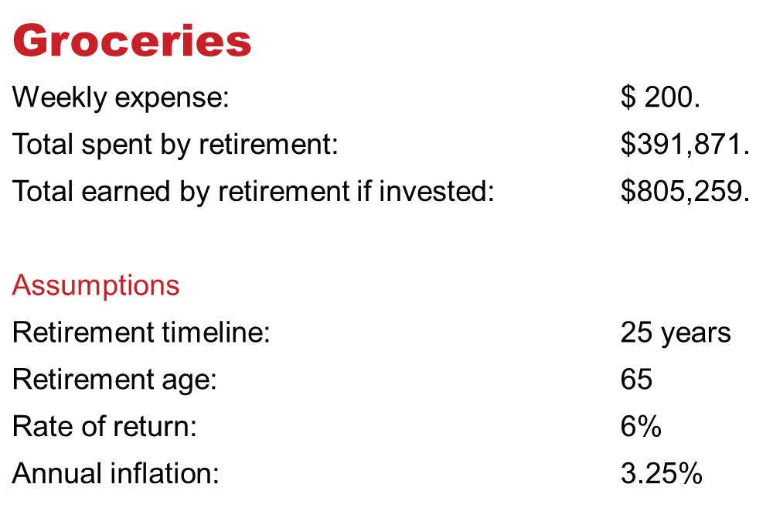
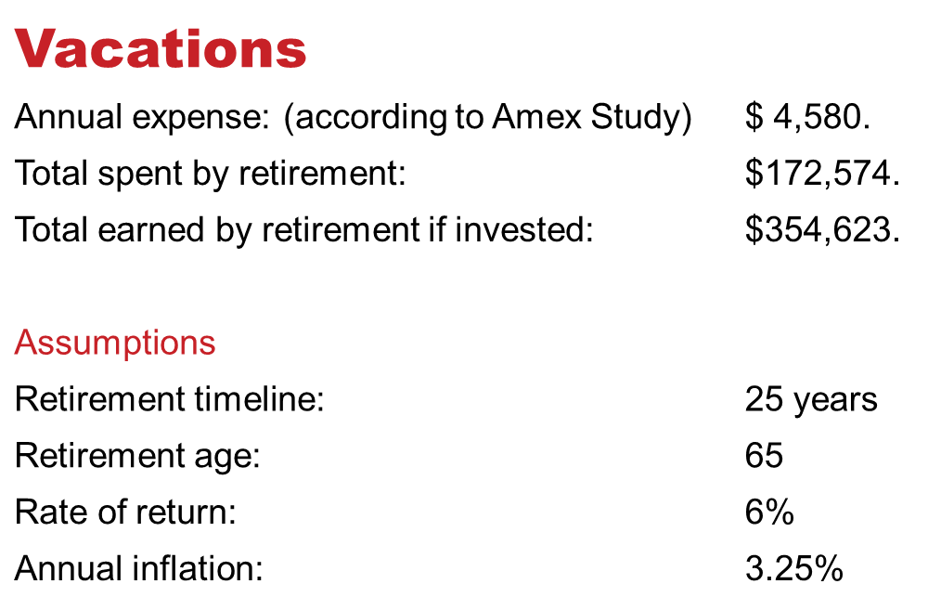
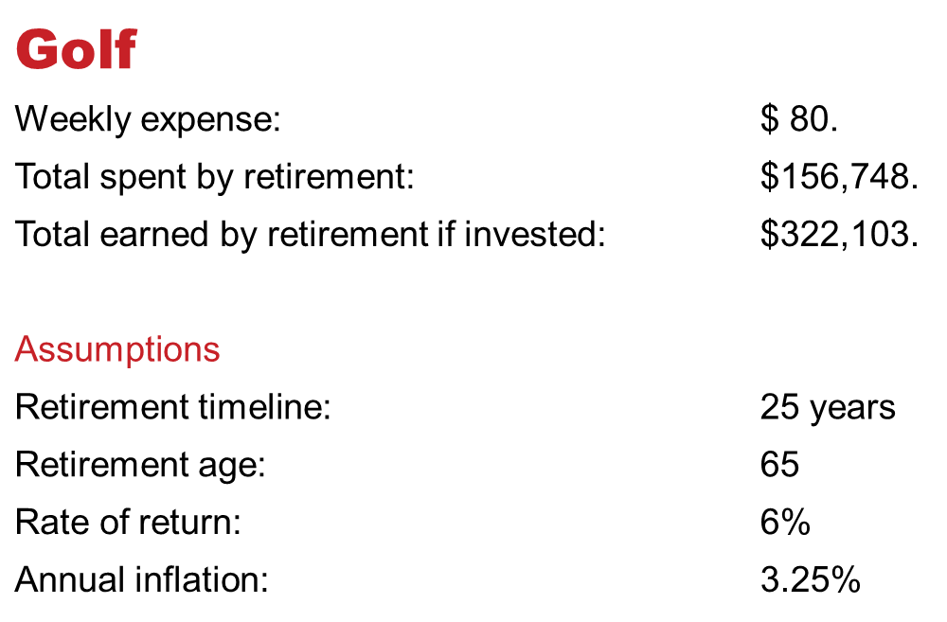
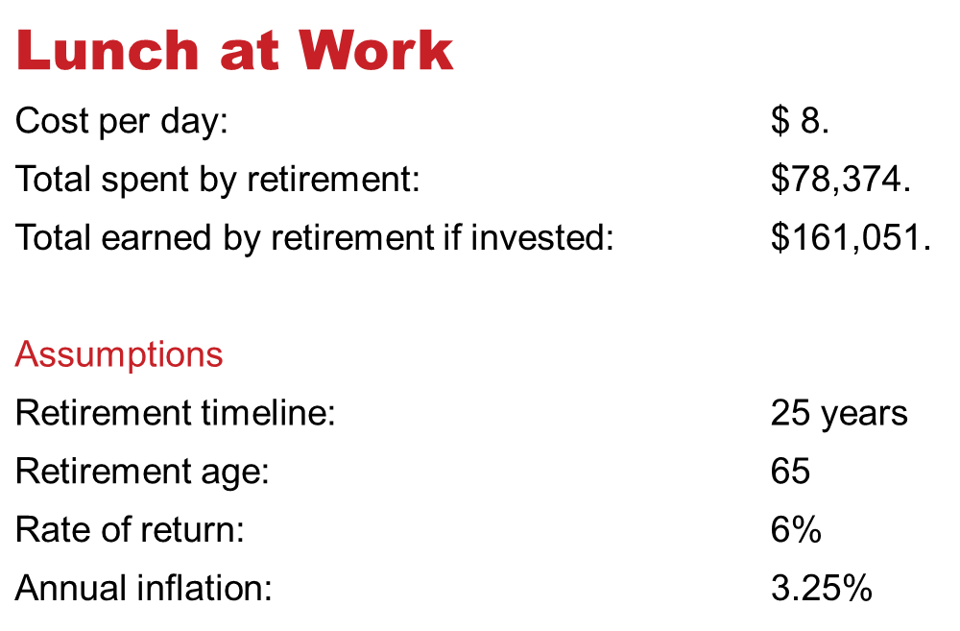
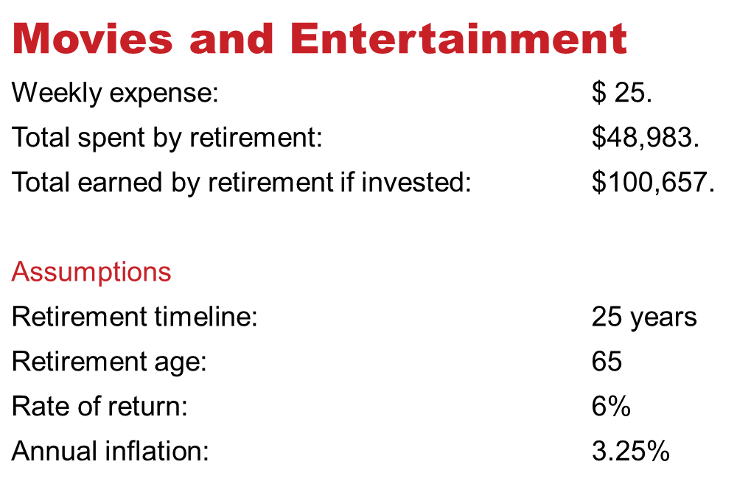
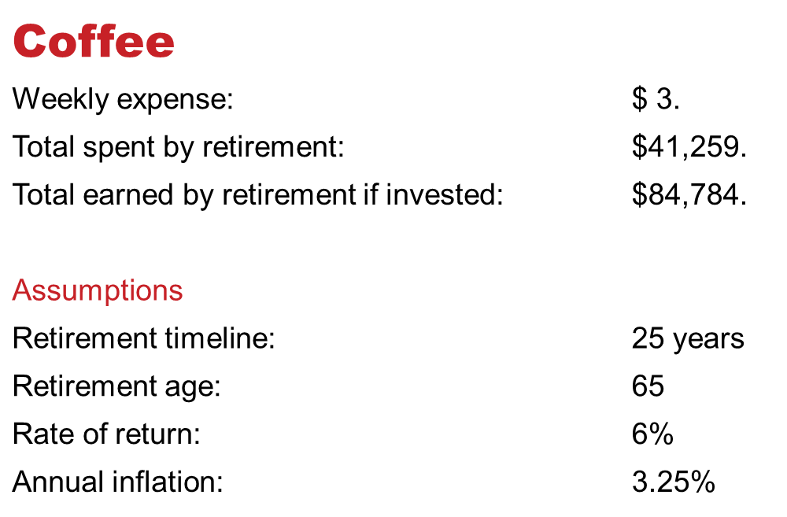
how we sometimes (all on one slide option)
overspend
Notes:
[Click on each icon symbol to launch the corresponding explanation slide]
For the slide:
GROCERIES
Weekly expense: $200
Total spent by retirement: $391,871
Total earned by retirement if invested: $805,259
Assumptions:
Retirement timeline: 25 years
Retirement age: 65
Rate of return: 6%
Annual inflation: 3.25%
VACATIONS
Annual expense: $4,580 (according to Amex study)
Total spent by retirement: $172,574
Total earned by retirement if invested: $354,623
Assumptions:
Retirement timeline: 25 years
Retirement age: 65
Rate of return: 6%
Annual inflation: 3.25%
GOLF
Weekly expense: $80
Total spent by retirement: $156,748
Total earned by retirement if invested: $322,103
Assumptions:
Retirement timeline: 25 years
Retirement age: 65
Rate of return: 6%
Annual inflation: 3.25%
LUNCH AT WORK
Cost per work day: $8
Total spent by retirement: $78,374
Total earned by retirement if invested: $161,051
Assumptions:
Retirement timeline: 25 years
Retirement age: 65
Rate of return: 6%
Annual inflation: 3.25%
COFFEE
Daily expense: $3
Total spent by retirement: $41,259
Total earned by retirement if invested: $84,784
Assumptions:
Retirement timeline: 25 years
Retirement age: 65
Rate of return: 6%
Annual inflation: 3.25%
MOVIES & ENTERTAINMENT
Weekly expense: $25
Total spent by retirement: $48,983
Total earned by retirement if invested: $100,657
Assumptions:
Retirement timeline: 25 years
Retirement age: 65
Rate of return: 6%
Annual inflation: 3.25%
Script notes:
There are lots of ways we overspend. It could be on groceries … vacations … golf (although some people would say there’s no such thing as too much golf!) … buying lunch every day at work … pricey coffee … handbags and clothes we don’t really need … and on and on … the list is endless.
How much could you save if you didn’t spend money on those things? It can add up in a big way. Take a look at some rough calculations based on some standard assumptions. (Click some items and discuss.)
Now that we’ve taken a look at how we spend, and maybe overspend, let’s begin building a plan that will allow us to experience the power of change. To start budgeting and saving, it helps to change our perspective. Here’s what I’m talking about …

