Slide 1
Be
a
Super Saver!
Plan name here
Presenter’s Name TITLE
Notes:
Welcome and thank you for joining me today!
My name is [introduce yourself and give some background that your audience may find interesting/relevant]
First by a show of hands, how many of you are enrolled in the company's retirement plan? Terrific - that is the first huge step in securing your financial future.
What we're going to talk about today is taking the next step - becoming a super saver to help ensure you meet your retirement goals.

Slide 2
today’s
goals
Becoming a Super Saver
Small changes, big results
Tools and resources
Next steps
Notes:
Today’s goals are pretty simple. We’ll talk about what it means to be a Super Saver, how some small changes to everyday habits can make a big difference down the road, and how your retirement plan makes it easier for you to reach your goals. I'll make sure you clearly understand what your next steps should be.

Slide 3
you
determine what your retirement
looks like
Notes:
So, how many of you can picture yourself travelling in retirement? A big RV or catamaran? [solicit audience participation]. What about building that lake house and spending your days fishing? [solicit audience participation]. Any other retirement dreams?
Those all sound great. But here’s the truth – you are pretty much the only person who can make that happen. The fact is you have to start saving TODAY if you want to have any chance of making those dreams a reality in retirement.

Slide 4
small changes,
big difference
retirement
$38,308.96
coffee
$3.00 per weekday x 20 years
$21,500.11
Assumptions: 3.25% annual inflation rate, 6% annualized growth in retirement account
Source: TA-retirement.com “Loose Change Calculator”
Notes:
Let’s start with a common example about spending versus saving. And I don’t mean splurging on big-ticket items like luxury cars or built-in refrigerators. Instead, let’s talk about the small stuff—things we might be paying for every day. Because while they may not seem significant, minor changes in your spending habits can add up to a much healthier nest egg.
How many of you enjoy a coffee run on your way to work? [Solicit Audience Responses]
We know it’s convenient, tasty, and can really get you going. But the fact is, today’s seemingly small purchase could cost you a bundle tomorrow.
Let’s say you spend around $3 a day, five days a week, on a [use air quotes] “nice” cup of coffee. Let’s also say you plan to retire in 20 years.
By the time you retire, those little cups of joe that only cost you $3 a day will have set you back more than $21,500 after inflation. No wonder one of the big chains has bucks in its name!
If you were to forego that coffee and invest that money in your retirement savings plan, that $3 a day could grow to more than $38,300—-assuming that the investments in your retirement account earned about 6% per year. Just something to keep in mind the next time you’re in line. If you're thinking about traveling the world, buying a big RV and driving cross-country, or fishing at your lake house in retirement, your seemingly small investment could be a big help in the long-run.
Of course, this lesson isn’t limited to coffee. I’m sure there are plenty of other small changes you can make that can add up to more money for your future. Can you think of any? [Solicit Audience Responses]
Example pulled using ‘Loose Change Calculator’: https://www.ta-retirement.com/Portal/PlanningTools/calc_loose_change_01.aspx?UserType=R

Slide 5
set your
super savings
goals
5% or Match
10%
Max
Contribute 5% of pay—or enough to earn your full employer match
Contribute 10% of your current pay
Your plan’s maximum contribution: $18,000 ($24,000 if age 50+)
Matching contributions are subject to plan vesting requirements. Descriptions of plan features and benefits are subject to the plan document, which will govern in case of inconsistencies.
Notes:
[USE THIS SLIDE IF EMPLOYER OFFERS A MATCH]
I mentioned earlier that becoming a Super Saver can help you reach your retirement goals. But how much should you save to reach those goals is a tricky question for some. While everyone’s situation is a little different, there are three targets to consider shooting for.
First, consider contributing 5 percent of your pay, or at least enough to maximize the match you get from your employer. [In your case, PROVIDE MATCH DETAILS. So if you aren’t contributing at least XX%, you’re missing out on additional compensation from your employer!]
Once you reach your goal, consider upping your contribution to 10% of your salary. Many retirement planning professionals consider this a rule of thumb for putting aside today’s money for tomorrow’s expenses.
If you’re already doing that, consider saving up to your plan’s maximum of $18,000 in 2015. And if you’ll be at least age 50 this calendar year, you can save another $6,000 in 2015 with so-called catch-up contributions. This will really help put you on the path toward a brighter retirement.

Slide 6
set your
super savings
goals
5%
10%
Max
Contribute 5% of your current pay
Contribute 10% of your current pay
Your plan’s maximum contribution: $18,000 ($24,000 if age 50+)
Notes:
[USE THIS SLIDE IF EMPLOYER DOES NOT OFFER A MATCH]
So you’ve seen how the cost of little extras can add up to lost retirement savings. But how should you set your savings goals? While everyone’s situation is a little different, there are three goals to consider shooting for.
The first: consider contributing at least 5% of your current salary to get started.
Once you reach your goal, consider upping your contribution to 10% of your salary. Many retirement planning professionals consider this a rule of thumb for putting aside today’s money for tomorrow’s expenses.
If you’re already doing that, consider saving up to your plan’s maximum of $18,000 in 2015.

Slide 7
Save even more with
catch-up
contributions
Notes:
With retirement, while it’s generally best to save as much as you can as soon as you can, don’t lose hope if you didn’t start as early as you wish you would have. That’s because even if you’re behind, it’s not too late to unleash your inner Super Saver. In fact, if you’ll be at least age 50 this year, you can do even more to grow a bigger nest egg.
You might have noticed that the last goal—your plan maximum—showed two different amounts allowed each year.
That’s because there are two limits—one for regular contributions, and one to give people who’ve hit the big 5-O the chance to make up lost time. The regular contribution limit is $18,000 in 2016. But if you’re 50 or older by the end of the calendar year, you can also make catch-up contributions—an extra $6,000 for 2016.
This means that if you qualify, you can put away up to $24,000 in your account this year. That’s one way to help you close your gaps and avoid saying woulda-coulda-shoulda.

Slide 8
anything
don’t let
block your view
I can’t afford to save any
more than I’m saving already.
I’ll increase my savings next year.
It seems so complicated.
Notes:
One thing I hear a lot as I talk to people in meetings like this, is that they think they can't save any more. I bet at least some of you are thinking one of these things:
I can't afford to increase my savings; I need every dollar in my paycheck!
I'll definitely increase my savings....next year.
It seems so complicated.
In reality, all these excuses do is BLOCK YOUR VIEW of the future. So let’s tackle each one and see what we can do to CLEAR THE AIR.

Slide 9
EXCUSE 1
I can’t afford to save more.
...the snowball effect.
Even a Little Can Add Up
Even a little can add up
$25 a week
Grows free from taxes until withdrawn
In 10 years
$17,686
In 25 years
$73,619
In 35 years
$149,527
Assumptions: $25 weekly contributions, 6% annualized return. Assumed rate of return does not reflect the return of any specific investment and is not meant to imply or guarantee future results. Investing in any fund involves risk. An investment’s return and principal value will fluctuate, so your interest may be worth more or less than the original cost. There is no assurance that any fund will meet its stated objective.
Notes:
Let me show you how putting even a little away each week can add up to a lot over time, "I'll just wait until next year", and "It seems so complicated." All these excuses do is BLOCK YOUR VIEW of the future.
It’s thanks largely to the tax advantage I mentioned earlier, where your earnings stay in the plan and keep growing year after year. We call this the snowball effect. [CLICK]
Here’s an example. Say you put aside $25 a week in your plan [CLICK], where it can grow tax deferred. [CLICK] Let’s also assume your money earns 6 percent a year on average. That’s less than stocks have returned over long periods in the past, but of course we can’t predict the future. So, $25 a week -- the price of a cup of coffee each day. How much do you think you’ll have saved after 10 years? [Solicit guesses from audience. Comment on them.]
[CLICK] In 10 years, that $25 a week will have grown to almost $18,000. What do you think it would be in 25 years? [Solicit guesses from audience. Comment on them.] [CLICK] In just a little over double the time, you would have more than tripled your savings to over $73,000. But wait, by saving for only 10 more years [CLICK] you could pile up almost $150,000. That’s the power of tax-deferred compounding. [CLICK]
Assumptions: $25 per week contribution, 6% rate of return. Source: Dinky Town 401(k) Savings Calculator, dinkytown.net

Slide 10
piling
on to the snowball effect
Employer match and earnings
+
$149,527
(your own savings/earnings)
Matching contributions are subject to plan vesting requirements. Descriptions of plan features and benefits are subject to the plan document, which will govern in case of inconsistencies.
Notes:
[Use this slide only if employer offers a match]
That’s just with your contributions. But the snowball effect gets even better–and bigger–with your employer’s match. [CLICK]
Remember, the contributions your employer makes will stay in the plan and continue compounding year after year as well – same snowball effect, but on that free money your company adds to your account.
As long as you save enough to take full advantage of the match, you can accumulate significantly more over the same timeframe.
That’s a lot of extra resources for your future [CLICK] That’s sure to put a smile on anyone’s face!

Slide 11
EXCUSE 2
…it doesn’t pay to delay.
I’ll just wait until next year.
Jill stops contributing at age 35, but the money in her plan continues to grow.
21
35
45
55
65
Jill starts early at age 21, saving $30 a week.
35
45
55
65
Jack waits until age 35 before he starts saving $30 a week.
Notes:
For anyone thinking it'll be easier to save more next year, consider the story of Jack and Jill. No hills in sight for this pair—just flat, fertile ground for growing a nest egg.
Both Jack and Jill are 21, and both of their employers offer a retirement savings plan much like the one you have.
Jill decides to start saving $30 a week right away. She contributes steadily for 14 years and then stops, but leaves her money in her plan to grow for the next 30 years. Jack, on the other hand, waits until he is 35 to start saving that same $30 a week, and he keeps contributing every week for the next 30 years.
Who do you think will have more at retirement? [solicit audience participation]

Slide 12
Why it doesn’t pay to delay
Over 14 years, Jill contributes $21,840
but ends up with $193,994.
Over 30 years, Jack contributes $46,800
but ends up with $127,066.
Jill saves $66,928 more!
Assumptions: 6% annual returns, with no wage increases or inflation. Example is hypothetical and does not reflect the performance of any fund. Regular investing does not guarantee a profit or protect against a loss in a declining market. Past performance does not guarantee future results. Initial taxes on contributions and earnings are deferred until distribution.
Notes:
Jill’s total contributions to her plan are $21,840.
Meanwhile, Jack contributes more than twice this amount at $46,800.
But here’s the thing: By starting earlier and leveraging the power of tax-deferred compounding, Jill ends up with nearly $194,000 at retirement, compared to just $127,000 for Jack.
Think about it: Jill contributes less than half of what Jack does and still ends up with almost $67,000 more--all because she started early.
And remember, we’re talking about what could happen by saving only $30 a week. What’s more, our example assumes average gains of 6 percent a year. If you do better, your nest egg will grow even bigger.
Obviously, this is just an illustration, and your specific results will vary, but you can see the potential advantages of starting early.

Slide 13
save more
automatically
10%
5%
6%
7%
8%
9%
You choose how much to increase your savings each year.
We’ll raise your contribution amount automatically as you specify.
Sign up for auto-increase at [my.trsretire.com]
You should evaluate your ability to continue the auto-increase service service in the event of a prolonged market decline, unexpected expenses, or an unforeseeable emergency.
Notes:
[USE THIS SLIDE WITH P3 PLANS THAT OFFER the auto-increase service]
Fortunately, your employer’s retirement plan even an easy way to save more every year. We call it auto-increase. This free online service lets you schedule automatic annual increases to your contributions, on the date you choose, by the amount you choose. This can get you to your optimal savings rate gradually—without you having to remember to request it.
You can sign up—or cancel —any time at [my.trsretire.com].

Slide 14
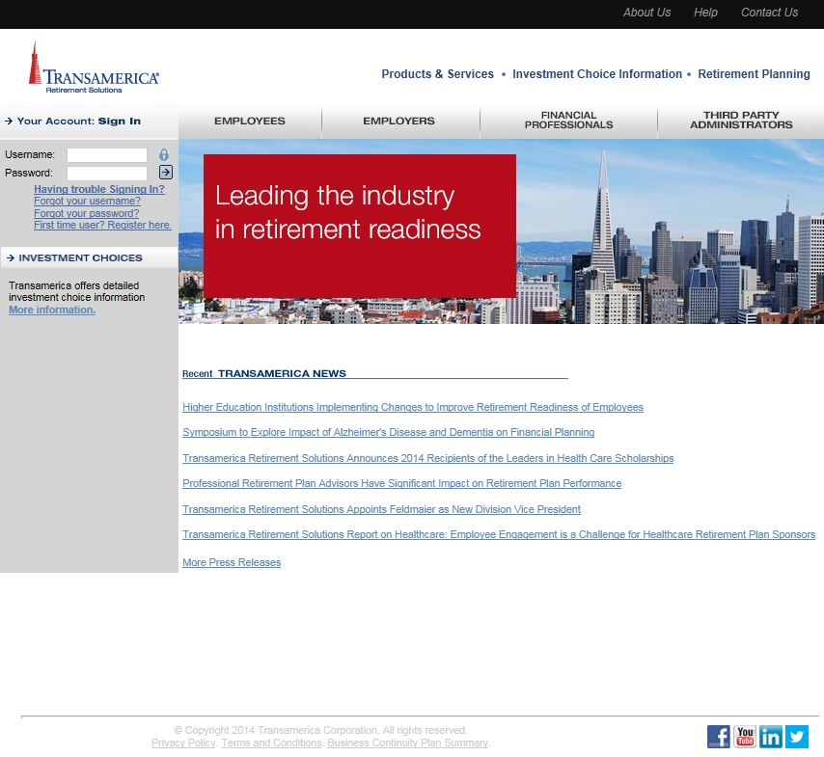
save more
automatically
10%
5%
6%
7%
8%
9%
You choose how much to increase your savings each year.
We’ll raise your contribution amount automatically as you specify.
Sign up for auto-increase at TA-Retirement.com
You should evaluate your ability to continue the auto-increase service service in the event of a prolonged market decline, unexpected expenses, or an unforeseeable emergency.
Notes:
[For EM PLANS NOT ON P3 THAT OFFER AUTO-INCREASE]
Fortunately, your employer’s retirement plan even offers an easy way to save more every year. We call it auto-increase. This free online service lets you schedule automatic annual increases to your contributions, on the date you choose, by the amount you choose. This can get you to your optimal savings rate gradually—without you having to remember to request it.
You can sign up—or cancel—any time at TA-Retirement.com.

Slide 15
save more
regularly
10%
5%
6%
7%
8%
9%
Get in the habit: Raise your savings level a little each year
Think of it as a birthday gift for your future retirement!
Notes:
[USE THIS SLIDE WITH PLANS THAT DO NOT OFFER the auto-increase service]
If you’re like many busy people, increasing your retirement savings plan contributions may not be on the top of your to-do list. But as I noted, small, regular increases can make a big difference in your savings over time.
So try to get in the habit of raising your savings rate a little each year. Mark a day on your calendar, maybe your birthday, as a constant reminder to increase your contributions. Think of it as a birthday gift to the future you.

Slide 16
the
saver’s credit
Lowers federal income taxes dollar for dollar
Like a rebate
10%, 20%, or 50% of the first $2,000 you contribute (depending on your income and tax filing status)
Up to $1,000 back
$2,000 if you file jointly and each contribute $2,000
Maximum 2016 adjusted gross income (AGI) to qualify for credit: $30,750 (single filers), $46,125 (heads of household), $61,500 (joint filers). Visit irs.gov for more information..
Notes:
16
[OPTIONAL SLIDE]
There’s another way the federal government encourages people to save for retirement. It’s with the so-called Saver’s Credit. A tax credit is different from--and even better than--a tax deduction. That’s because while a deduction means only a percentage tax cut based on your federal bracket, a credit cuts your tax bill dollar for dollar.
In fact, the Saver’s Credit is like an instant rebate when you file your return. Depending on your income and tax filing status, you may be able to get back 10, 20, or even 50 percent of the first $2,000 you contribute to your retirement plan in 2016. That means you could cut your tax bill by up to $1,000--or even $2,000 if you’re married and file jointly.
Even so, not everyone will qualify for this deal. The Saver’s Credit is designed to help taxpayers with low to moderate incomes. And even if you fit that bill, you might not be eligible if you took money out of your retirement account within the past two years. So ask your tax advisor to check your eligibility, or visit the IRS website at irs.gov.

Slide 17
one place to manage
your savings
Consolidate other retirement plan assets you may have to:
Easily manage your savings
Important: The projections or other information generated by the OnTrack® tool regarding the likelihood of various investment outcomes are hypothetical, do not reflect actual investment results, and are not guarantees of future results. Results derived from the OnTrack® tool may vary with each use and over time. Please visit your plan website for more information regarding the criteria and methodology used, the tool’s limitations and key assumptions, and other important information.
Get a more complete view
Stay diversified
Employer-sponsored retirement plans may have features that you may find beneficial such as access to institutional funds, fiduciary selected investments, and other ERISA protections not afforded other investors. In deciding whether to do a rollover from a retirement plan, be sure to consider whether the asset transfer changes any features or benefits that may be important to you.
In some cases your prior provider may charge a surrender or withdrawal fee for transferring your account. Contact the provider to confirm if any fees apply to you. Review the fees and expenses you pay, including any charges associated with transferring your account, to see if consolidating accounts could help reduce your costs. Be sure to consider whether a transfer changes features or benefits that may be important to you.
Notes:
[OPTIONAL SLIDE]
As you figure out ways to save more, you may want to consider consolidating your assets.
Don’t think I’m saying “put all your eggs in one basket” – I still want you to have diversified investments. But here I’m talking about keeping all your various retirement accounts in one place, so it will be easier for you to see the big picture. The money itself should still be invested in a diverse mix of funds.
There are 2 ways you can consolidate your assets with Transamerica. Both give you the advantage of being able to see all of your money in one place -- so that when you use the OnTrack ® tool to see your Outlook, you will be able to see all of your retirement assets. The two options are:
1). You can roll that money into the plan, giving you access to the same investment options, services and features that you have through your employer's plan. One of the biggest advantages is that the fees you pay in the plan are typically lower than what you would have to pay for those same funds on your own. But your account will be assessed any other administrative fees.
2). Alternatively, you can roll that money to a Transamerica IRA, which gives you more investment flexibility and access to investment advice, if you'd like. You might consider this option if you don't want all of you retirement assets with your current employer for whatever reason.

Slide 18
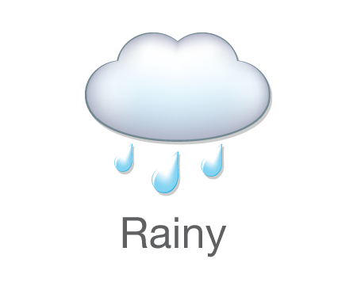
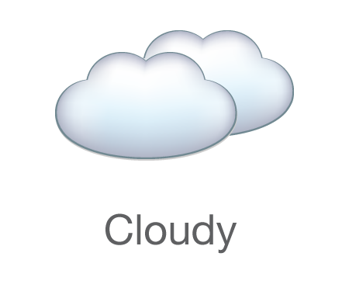
monitor your progress
Your Retirement Outlook
®
Will you have the income you’ll need?
Less than 65% of your goal
65% to 79% of your goal
80% to 94% of your goal
At least 95% of your goal
IMPORTANT: The projections or other information generated by the OnTrack® tool (which generates Your Retirement Outlook®) regarding the likelihood of various investment outcomes are hypothetical, do not reflect actual investment results, and do not guarantee future results. Results derived from the OnTrack® tool may vary with each use and over time. See the slides at the end for details on the criteria and methodology used, the tool’s limitations and key assumptions, and other important information.
Please visit your plan website for more information regarding the criteria and methodology used, the tool’s limitations and key assumptions, and other important information.
Notes:
Now, a super saver also knows that it’s important to monitor their progress to know where they stand and where they need to go, to reach their goals. Luckily, your retirement plan offers a clear, simple gauge of your retirement savings progress.
We call it Your Retirement Outlook®. It’s a quick, personalized way to gauge your savings progress in real time. It can even alert you to take action when or if you’re falling behind.
Specifically, Your Retirement Outlook is our name for the gap between your retirement income goal and how much income your current strategy is likely to produce when you retire. You can learn your individual forecast when you set up your account online by answering a few simple questions. Once you do, you’ll see one of these four weather icons – rainy, cloudy, partly sunny, or sunny. Each one represents how much of your goal your current strategy is likely to reach.
Obviously, you want your forecast to be sunny. But don’t worry if it’s not. Your Retirement Outlook is a real-time gap analysis…a snapshot of where you stand versus your goal--right now. You create it by using our powerful OnTrack planning tool. But OnTrack doesn’t just show you your current forecast; it also shows you how you may be able to improve it. That might mean saving more, as we’ve talked about. But it could mean saying more. That’s because the more information you provide about your retirement picture, including any outside accounts, income or expenses for both yourself and your spouse or partner, the clearer Your Retirement Outlook will be. What’s more, your forecast updates automatically every time you sign into your account.

Slide 19
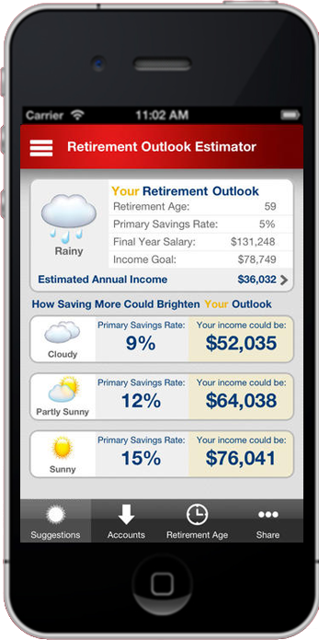
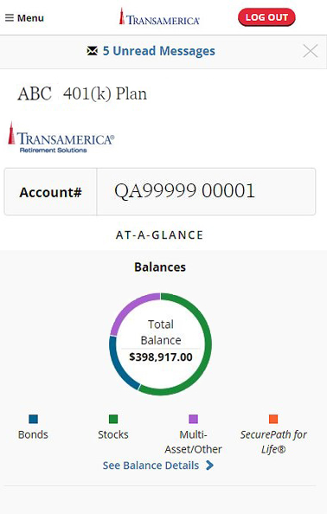
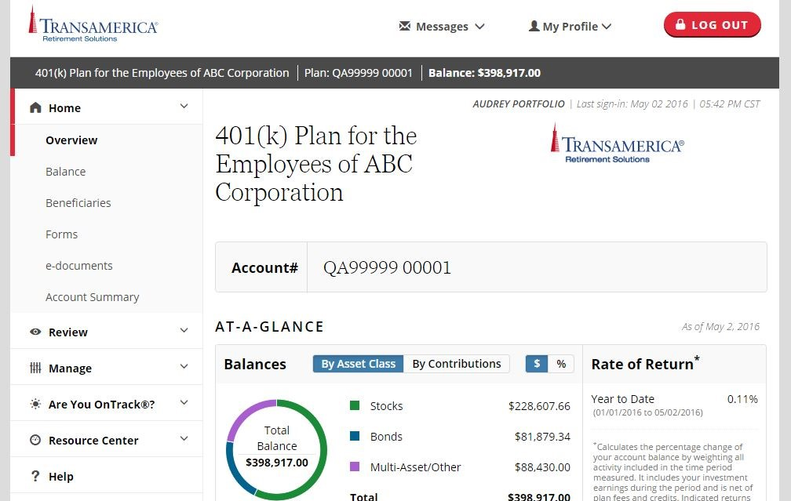
online
access
[my.trsretire.com]
My TRSRetire
Notes:
[FOR PLANS ON P3, make sure URL is correct]
We make it easy for you to track and manage your account online. Simply visit [my.trsretire.com] or [custom web portal] on your computer and download our My TRSRetire app for your mobile device.
Besides the basics, like updating your personal profile and account beneficiaries, reviewing account activity and performance and fees for the funds in your plan, you’ll find a variety of calculators and other tools that can make managing your account a breeze.

Slide 20
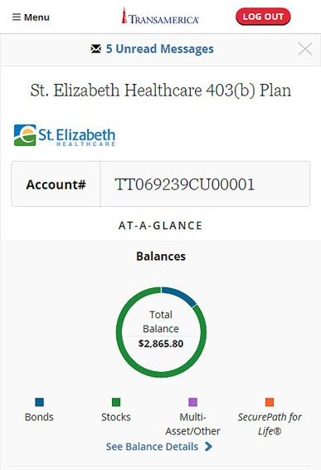
online
access
TA-Retirement.com
My TRSRetire
Notes:
[FOR EM PLANS NOT ON P3, make sure URL is correct]
We make it easy for you to track and manage your account online. Simply visit [TA-Retirement.com] or [custom web portal] on your computer or download our My TRSRetire app for your mobile device.
Besides the basics, like updating your personal profile and account beneficiaries, reviewing account activity and performance and fees for the funds in your plan, you’ll find a variety of calculators and other tools that can make managing your account a breeze.

Slide 21
action!
take
Target the right savings goal–at least enough to earn your full match
Schedule annual raises with auto-increase
Make catch-up contributions (age 50+)
Know Your Retirement Outlook®
Think about what it will take to be a Super Saver!
Matching contributions are subject to plan vesting requirements. Descriptions of plan features and benefits are subject to the plan document, which will govern in case of inconsistencies.
Notes:
[FOR PLANS WITH MATCH AND WITH AUTO-INCREASE]
I’m hoping that your next steps are pretty apparent by now. But to recap:
First, identify the savings goal that’s right for you–consider putting away at least [enough to take full advantage of your company match][OR 5%]. Remember that even more is even better!
Next, commit to raising your contributions a little each year with our auto-increase service. The service is free, and you can turn it off at any time.
Also, if you’re at least age 50, consider taking advantage of your plan’s higher catch-up contribution limits.
Remember to sign in to your account regularly to check Your Retirement Outlook and make any changes you might need to.
Finally, think about what it will take for you to be a Super Saver! What's holding you back? Fear, over-spending, bad debt? We have resources to help you get there!

Slide 22
action!
take
Target the right savings goal–at least 5% to start
Schedule annual raises with auto-increase
Make catch-up contributions (age 50+)
Know Your Retirement Outlook®
Think about what it will take to be a Super Saver!
Evaluate your ability to continue the auto-increase service in the event of a prolonged market decline, unexpected expenses, or unforeseeable emergencies.
Notes:
[FOR PLANS WITH AUTO-INCREASE, BUT NO MATCH ]
I’m hoping that your next steps are pretty apparent.
First, identify the savings goal that’s right for you–5% of your pay is a good starting point. Remember that even more is even better!
Then commit to raising your contributions a little each year with our auto-increase service. The service is free, and you can turn it off at any time.
Also, if you’re at least age 50, consider taking advantage of your plan’s higher catch-up contribution limits.
Don't forget to sign in to your account regularly to check Your Retirement Outlook and make any changes you might need to.
Finally, think about what it will take for you to be a Super Saver! What's holding you back? Fear, over-spending, bad debt? We have resources to help you get there!

Slide 23
action!
take
Target the right savings goal–at least enough to earn your full match
Raise your contributions every year
Make catch-up contributions (age 50+)
Know Your Retirement Outlook®
Think about what it will take to be a Super Saver!
Notes:
[FOR PLANS WITH MATCH BUT NO AUTO-INCREASE]
I’m hoping that your next steps are pretty apparent by now. But to recap:
First, identify the savings goal that’s right for you–consider putting away at least enough to take full advantage of your company match. Remember that even more is even better!
Then commit to raising your contributions a little each year.
Also, if you’re at least age 50, consider taking advantage of your plan’s higher catch-up contribution limits.
Remember to sign in to your account regularly to check Your Retirement Outlook and make any changes you might need to.
Finally, think about what it will take for you to be a Super Saver! What's holding you back? Fear, over-spending, bad debt? We have resources to help you get there!

Slide 24
action!
take
Target the right savings goal–at least 5% to start
Raise your contributions every year
Make catch-up contributions (age 50+)
Know Your Retirement Outlook®
Think about what it will take to be a Super Saver!
Notes:
[FOR PLANS WITH NO MATCH AND NO AUTO-INCREASE]
First, identify the savings goal that’s right for you–5% of your pay is a good starting point. Remember that even more is even better!
Then commit to raising your contributions a little each year. The service is free, and you can turn it off at any time.
Also, if you’re age 50 or older, consider taking advantage of your plan’s higher limits on so-called catch-up contributions.
Remember to sign in to your account regularly to check Your Retirement Outlook and make any changes you might need to.
Finally, think about what it will take for you to be a Super Saver! What's holding you back? Fear, over-spending, bad debt? We have resources to help you get there!

Slide 25
OnTrack® Tool: About Probability Illustrations, Limitations, and Key Assumptions
The probability illustrations the OnTrack® tool generates are based on “Monte Carlo” simulations of 500 possible investment scenarios for a given time period and assume a range of possible returns. The illustrations are generated according to models developed by Ibbotson Associates, a leading independent provider of asset allocation, analytical, and wealth forecasting software. The Your Retirement OutlookSM graphic reflects the difference between the model’s estimated annual income (which corresponds to a 70% probability of achieving your income goal in the investment scenarios simulated) and your annual income goal.
When forecasting the probability of achieving your income goal, the model employs different returns for different asset classes, based on Ibbotson’s capital market assumptions developed using historical and forward-looking data. Current assets are assigned to asset classes based on Morningstar categories, and fees and charges inherent in investing are incorporated with an average fee assumption for each asset class. The historical and forward-looking benchmarks used for modeling the various asset classes are below. Return assumptions are updated annually; these updates may have a material impact on your projections. Return assumptions are estimates not guarantees. The returns you experience may be materially different than projected. You cannot invest directly in an index.
.

Slide 26
OnTrack® Tool: Benchmark Indexes
Asset Class | Forward-Looking Benchmark | Historical Benchmark
Cash | Citigroup 3-Month Treasury Bill | Ibbotson SBBI T-Bill Index
Short-Term Bonds | Barclays U.S. Treasury 1-3 Yr Term Index | Ibbotson 2 Yr Treasury Index
TIPS | Barclays Capital U.S. Treasury: U.S. TIPS | Ibbotson TIPS Index
Aggregate Bonds | Barclays Capital U.S. Aggregate Index | Barclays Capital U.S. Aggregate Index
Long-Term Bonds | Barclays Capital U.S. Long Credit A Index | Ibbotson 25 Year Treasury Index
High-Yield Bonds | Barclays Capital U.S. Corporate High Yield Index | Ibbotson High Yield Index
International Bonds | Citigroup WGBI | Ibbotson Global Bond Composite
Large-Cap Stocks | Russell 1000® Index | CRSP Declines Index
Mid-Cap Stocks | Russell Midcap Index | CRSP Declines Index
Small/Mid-Cap Stocks | Russell 2500® Index | CRSP Declines Index
Small-Cap Stocks | Russell 2000® Index | CRSP Declines Index
REITs | FTSE NAREIT Equity REITs | FTSE NAREIT Equity REITs
International Stocks | MSCI EAFE Index | MSCI EAFE Index
Emerging Markets | MSCI Emerging Markets Index | Ibbotson Emerging Market Composite
Commodities | DJ-UBSCISM | S&P GSCI Commodity Sector Indices
Lower Risk/ Volatility
Higher Risk/ Volatility
.

Slide 27
OnTrack® Tool: Assumptions and Limitations
Unless you choose otherwise or your employer supplies different information, the probability illustrations assume retirement at the age at which you qualify for full Social Security benefits and an annual retirement income goal of 80% of your projected final working salary. Social Security estimates are based on the Social Security Administration methodology and your current salary. The probability illustrations also assume a consistent contribution percentage (unless you’ve chosen to increase it periodically) and asset allocation (no future changes or rebalancing), annual inflation of approximately 2%, and annual salary increases based on a calculation that incorporates multiple factors including a salary growth curve and inflation. Mortality assumptions are based on the Society of Actuaries tables.
The models are subject to a number of limitations. Returns associated with market extremes may occur more frequently than assumed in the models. Some asset classes have relatively limited histories; for these classes the models use historical data for shorter time periods. The model does not consider other asset classes such as hedge funds or private equity, which may have characteristics similar or superior to those used in the model.
There is no guarantee that your income goal will be achieved or that the aggregate accumulated amount will ensure a specified annual retirement income. Results derived from the OnTrack® tool may vary with each use and over time.
IMPORTANT: The projections or other information generated by the OnTrack® tool regarding the likelihood of various investment outcomes are hypothetical, do not reflect actual investment results, and do not guarantee future results. Moreover, even though the tool’s estimates are statistically sound based upon the simulations it runs, the tool cannot foresee or account for every possible scenario that may negatively impact your situation. Thus you should monitor your account regularly and base your investment decisions on your time horizon, risk tolerance, and personal financial situation, as well as on the information in the prospectuses for investments you consider.
.

Slide 28
Registered funds are available by prospectus only. Any mutual fund offered under the plan is distributed by that particular fund's associated fund family and its affiliated broker-dealer or other broker-dealers with effective selling agreements such as Transamerica Investors Securities Corporation (TISC), 440 Mamaroneck Avenue, Harrison, NY 10528. The prospectus contains additional information about the funds, including the investment objectives, risks, charges, and other expenses. You should consider all such information carefully before investing. Call us at 800-755-5801 or visit my.trsretire.com for a free prospectus, and read it carefully before making your investment choices. Transamerica is affiliated with TISC, but is not affiliated with [COMPANY NAME].
The information in this seminar is general in nature and subject to change. Neither we nor TISC give legal or tax advice. Applicable laws and regulations are complex and subject to change. For legal or tax advice concerning your situation, please consult your attorney or professional tax advisor.
.
12082_PTSS0516
Notes:
RPC: ADD CLIENT NAME INTO DISCLOSURE

Slide 29
questions
& answers
Online:
By phone:
Notes:
RPC: choose one URL and one phone number to insert to slide:
my.trsretire.com or TA-retirement.com or custom URL
IM: 800-755-5801 (or custom #)
TAE CSC: 800- 401-8726
NAV CSC: 888- 637-8726
P3: 877- 234-9293

